Slide 1
JEOPARDY!
SPS Trivia
Notes:
This slide has animations. The word “jeopardy” zooms in and the “subtitle” spins and zooms. Also, there is auto play music that starts when the slide starts, but that music file must be saved in the same folder.

Slide 2
Game slide
physics JEOPARDY!
← Click the logo for Final Jeopardy!
Constants
SI Units
Conversions
Nuclear Physics
Miscellaneous
100 | 100 | 100 | 100 | 100
200 | 200 | 200 | 200 | 200
300 | 300 | 300 | 300 | 300
400 | 400 | 400 | 400 | 400
500 | 500 | 500 | 500 | 500
Notes:
This game slide must be edited on the slide (ie, by typing on to the slide directly in the appropriate text boxes. The heading boxes have a link to the explanations for the categories. The remainder of the slides can be edited in the “outline” view.
Use the outline view (on the left) and type clues where you see the word “clue”. The -clues corresponding to the clues should be put later. All the links should be tested before playing, and make sure that nothing gets deleted to avoid Foul ups.

Slide 3
CATEGORY 1 explanation
Constants

Slide 4
CATEGORY 2 explanation
SI Units

Slide 5
CATEGORY 3 explanation
Conversions

Slide 6
CATEGORY 4 explanation
Nuclear Physics

Slide 7
CATEGORY5 explanation
Miscellaneous

Slide 8
1-100 -clue
This is the value for the speed of light in a vacuum.

Slide 9
1-200 -clue
This is the value for the Boltzmann Constant.

Slide 10
1-300 -clue
This is the value for Avogadro’s Number.

Slide 11

1-400 -clue
This is the value for the gas constant in $\frac{J}{mol∗K}$

Slide 12
1-500 -clue
This is the value for Planck’s Constant.

Slide 13

2-100 -clue
This SI unit is equivalent to a
$$kg∗\frac{m}{s^{2}}$$

Slide 14

2-200 -clue
This SI unit is equivalent to a
$kg∗\frac{m^{2}}{s^{2}}$

Slide 15

2-300 -clue
This SI unit is equivalent to a
$\frac{C}{s}$

Slide 16

2-400 -clue
This SI unit is a
$\frac{J}{s}$

Slide 17

2-500 -clue
This SI unit is a
$\frac{J}{C}$

Slide 18
3-100 -clue
This is the conversion from inches to centimeters.

Slide 19
3-200 -clue
This is the conversion from kilograms to pounds.

Slide 20
3-300 -clue
This is the conversion from meters per second to miles per hour.

Slide 21
3-400 -clue
This is the equation to convert from Fahrenheit to Kelvin

Slide 22
3-500 -clue
This is the conversion from mL to gallons.

Slide 23
4-100 -clue
This famous physicist is known for the discovery of radium and has the distinction of being the only person to have won a Nobel Prize in two different sciences.

Slide 24
4-200 -clue
This term is commonly used to characterize how quickly unstable atoms undergo radioactive decay.

Slide 25
4-300 -clue
In this type of radioactive decay, an atomic nucleus emits an electron/positron and a antineutrino/neutrino.

Slide 26
4-400 -clue
This type of ionizing, electromagnetic radiation originates in the nucleus of an atom as a result of radioactive decay.

Slide 27
4-500 -clue
This humorous measurement used a common radioactive food as an informal way to quantify ionizing radiation exposure.

Slide 28
5-100 -clue
This is Newton’s third law of motion.

Slide 29

5-200 -clue
$$\text{These} \text{are} \text{the} \text{three} \text{major} \text{types} \text{of} \text{nuclear} \text{decay} \text{that} \text{radioactive} \text{particles} \text{can} \text{undergo}\text{.}$$

Slide 30

5-300 -clue
$$This is the first law of$$
$$thermodynamics.$$

Slide 31

5-400 -clue
$$These are the four fundamental$$
$$forces of nature.$$

Slide 32

5-500 -clue
$$This particle is sometimes called$$
$$the "antisocial Particle"$$

Slide 33
Q-1-100 - question
$What is 2.99792458∗{10}^{8}\frac{m}{s}$

Slide 34

Q-1-200 - question
$$What is 1.3806∗{10}^{−23}\frac{J}{K}$$

Slide 35
Q-1-300 - question
$$What is 6.022∗{10}^{23} mol^{−1}$$

Slide 36

Q-1-400 - question
$$What is 8.314\frac{J}{mol∗K}$$

Slide 37
Q-1-500 - question
$$What is 6.626∗{10}^{−34} J∗s$$

Slide 38
Q-2-100 - question
$$What is a Newton?$$

Slide 39
Q-2-200 - question
$$What is a Joule?$$

Slide 40
Q-2-300 - question
$$What is an Ampere?$$

Slide 41
Q-2-400 - question
$$What is a Watt?$$

Slide 42
Q-2-500 - question
$$What is a Volt?$$

Slide 43

Q-3-100 - question
$$What is$$
$$2.54\frac{cm}{inch}$$
or
$0.3937\frac{inch}{cm}$

Slide 44

Q-3-200 - question
$$What is$$
$$2.204\frac{lb}{kg}$$
$$\text{or}$$
$$0.4536\frac{kg}{lb}$$

Slide 45

Q-3-300 - question
$$What is$$
$$2.24\frac{mph}{\frac{m}{s}}$$
$$\text{or}$$
$$0.3937\frac{\frac{m}{s}}{mph}$$

Slide 46

Q-3-400 - question
$$What is$$
$$K=\frac{5}{9}\left(F−32\right)+273$$

Slide 47

Q-3-500 - question
$$What is$$
$$3785.4\frac{mL}{gallon}$$
$$\text{or}$$
$$0.000264\frac{gallon}{mL}$$

Slide 48
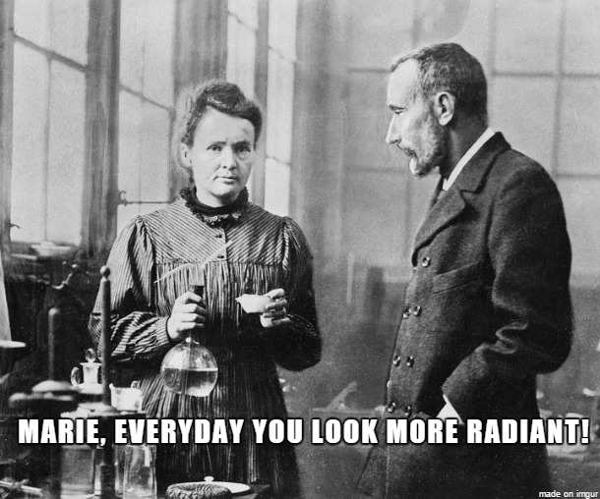

Q-4-100 - question
$Who is Marie Curie$?

Slide 49
Q-4-200 - question
$$What is Half Life?$$

Slide 50
Q-4-300 - question
$$What is Beta Decay?$$

Slide 51
Q-4-400 - question
$$What is Gamma Radiation?$$

Slide 52

Q-4-500 - question
$$What is the$$
$$Banana Equivalent Dose?$$

Slide 53

Q-5-100 - question
$$For every action, there is$$
$$an equal and opposite reaction.$$

Slide 54
Q-5-200 - question
$$What is alpha, beta, and gamma?$$

Slide 55

Q-5-300 - question
$$The internal energy of a closed system$$
$$is equal to the heat supplied to the$$
$$system minus the work done$$
$$by the system.$$
$$∆U=Q−W$$

Slide 56

Q-5-400 - question
$$What is Gravitational, Weak, Strong, \\ and Electromagnetic Force?$$

Slide 57
Q-5-500 – question
$$What is the Neutrino?$$

Slide 58
Final Jeopardy slide(logo)
FINAL
JEOPARDY

Slide 59
Final Jeopardy Category Name
Orbital Motion

Slide 60

Final Jeopardy clue (wave file starts on click)
Currently it takes ~365 days to orbit the sun, if the orbital radius was to double, how many days will it take to orbit the sun?

Slide 61

$$T=2π\sqrt{\frac{r^{3}}{GM}}$$
$$365∗\sqrt{8}≈1033 days.$$

Slide 62
Final Slide – no links
Thanks for Playing
PHYSICS
JEOPARDY

